Slide 1
QPECS Team 9
Final Presentation
Jackson Campolattaro (5625270)
Sian Hallsworth (5611393)
Yiwei Tao (5671078)

Slide 2
Experimental Setup
Notes:
Jackson

Slide 3
Full Factorial
After the midterm meeting, we decided to reduce the scope of our project
This meant fewer factors, which allowed us to perform a full-factorial evaluation with 3 replications for each configuration
Batch Size → 32, 128
Number of Epochs → 40, 80
Number of Nodes → 1, 2, 4
Notes:
Jackson

Slide 4
Fixed Parameters
We fixed the remaining parameters, with hardware and hyperparameters selected to ensure we could perform the experiments in a reasonable amount of time
Cores → 3
Memory → 2GB
Network → FashionMNISTCNN
Dataset → MNIST
Optimizer → Adam
Learning Rate → 0.001
Notes:
Jackson

Slide 5
Simulations
We experienced issues performing simulations for many configurations, so our regression model is built on data collected in batch mode
We were able to validate our operational-laws based model using data points from 15-minute simulations, using the following levels for each factor
Number of Epochs → 5, 10
Number of Nodes → 1, 2
Lambda → 0.5, 0.6
Notes:
Jackson

Slide 6
Analysis
Notes:
Jackson

Slide 7
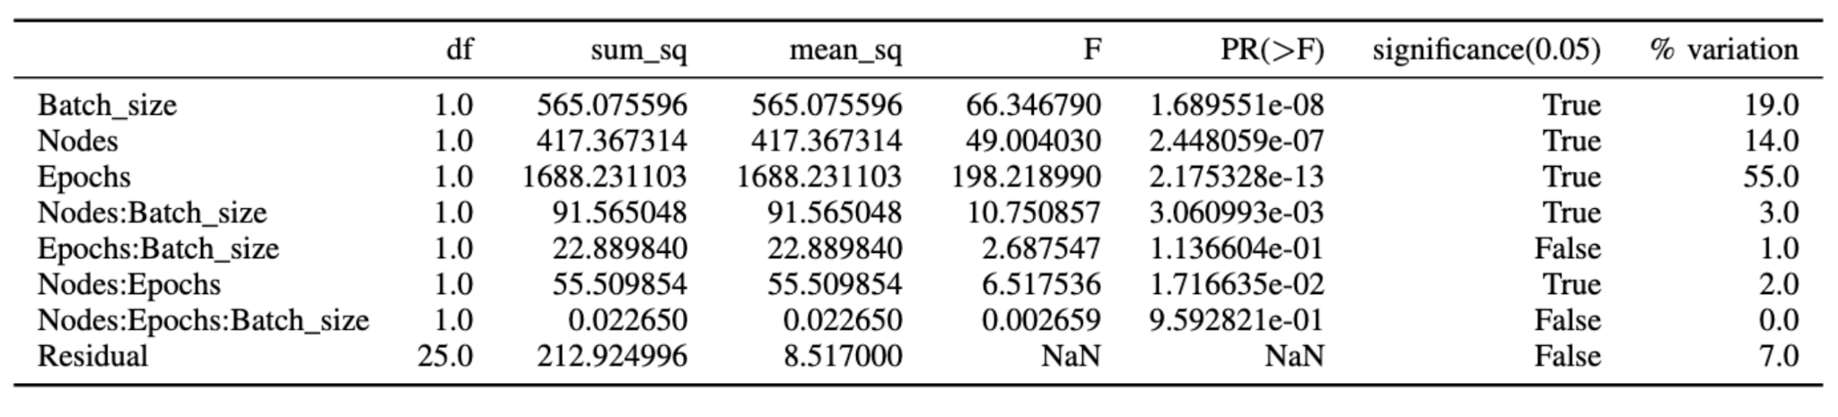
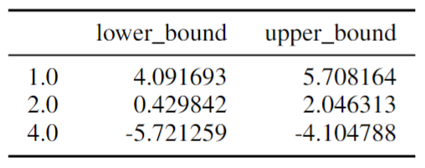
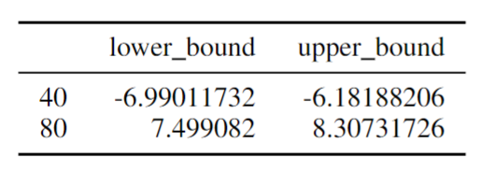
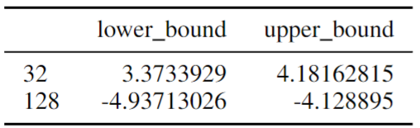
ANOVA
T-test
Analysis using ANOVA showed that each of our factors as well as many of the interactions between them were significant, with greater than 95% confidence
nodes
epochs
batch size
Notes:
Jackson

Slide 8
Regression Model

Slide 9
Description
We decided to fit a linear regression model which predicts the response time of a given configuration.
The regression equation:
Response time = 1.6828 - 5.7117(batch_size) + 0.6680(epochs) - 1.0140(nodes)
+ 1.2719(nodes:batch_size) - 0.0683(epochs:batch_size)
- 0.0688(nodes:epochs) - 0.0029(batch_size:nodes:epochs)
Notes:
Demi
At first, we construct the regression model based on the three factors and all their combination interactions. And we get the regression equation as shown in the slide.

Slide 10
Refinement using ANOVA Results
Based on our ANOVA results, we also fit a regression model which does not incorporate the Epochs:Batch-Size interaction, nor the three-way Nodes:Epochs:Batch-Size interaction
The regression equation:
Response time = 2.5815 - 9.0432(batch_size) + 0.653(epochs) - 0.5977(nodes)
+ 0.8777(nodes:batch_size) - 0.0757(nodes:epochs)
Notes:
Demi
But considering there are some factors are not significant, we refine the model by taking those factors out of consideration.
And we got the promoted regression equation.

Slide 11
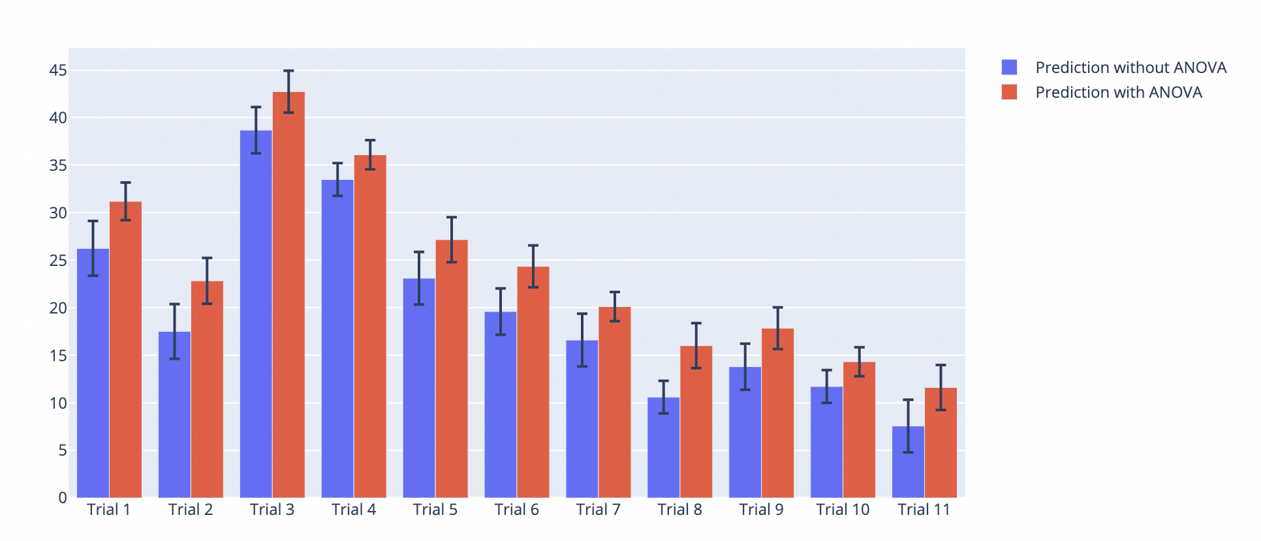
Validation – Accuracy
The original model and the model informed by our ANOVA results both achieved an R² accuracy of 93%
The predictions of the two models are largely similar, though the ANOVA-refined model consistently predicts higher service times.
Notes:
Demi
Both of the regression explains 93% of the variation of response time, while the model with ANOVA analysis results in smaller confidence intervals, which we believe model 2 give s a better estimation of the service time.

Slide 12
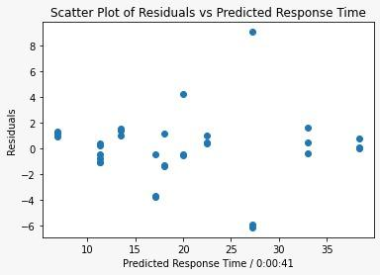
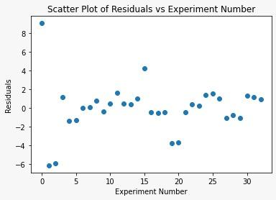
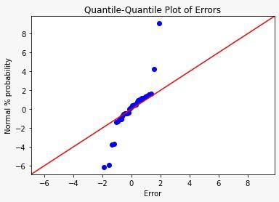
Validation – Checking Assumptions
Independent errors
Normally distributed errors
Constant standard deviation of errors
Notes:
Demi
To see whether we can draw the correct conclusions from the regression model, we also test assumptions for validation.
As discussed earlier, we have observed there should be a linear relation between response time and the factors, which lead us to build the regression model.
And from the first two plots, the residuals vs. predicted response time and vs. experiment number, we can see that the data points are scattered around, like random variables, and it indicates our errors are independent.
Besides, we have the Q-Q plot to show that error follows normal distribution. Almost all data points are scattered around the 45 degree diagonal line.
And also in the first plot, rather than becoming spread out, the residuals remain at the same level, and could be said to be constant.
So there is no need of transformation, and our model could be use.

Slide 13
Operational Law & Queue-based Models

Slide 14




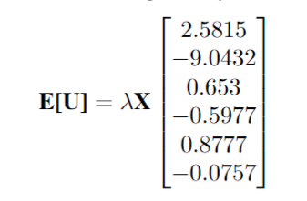
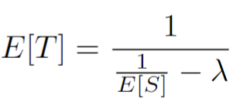
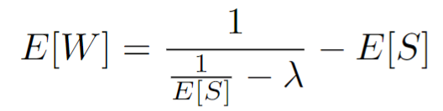
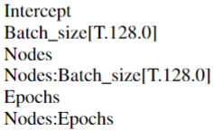
Description of Models
Queue: M/M/1
Utilization
Response Time
Waiting Time

Slide 15
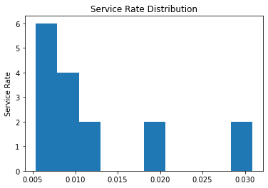
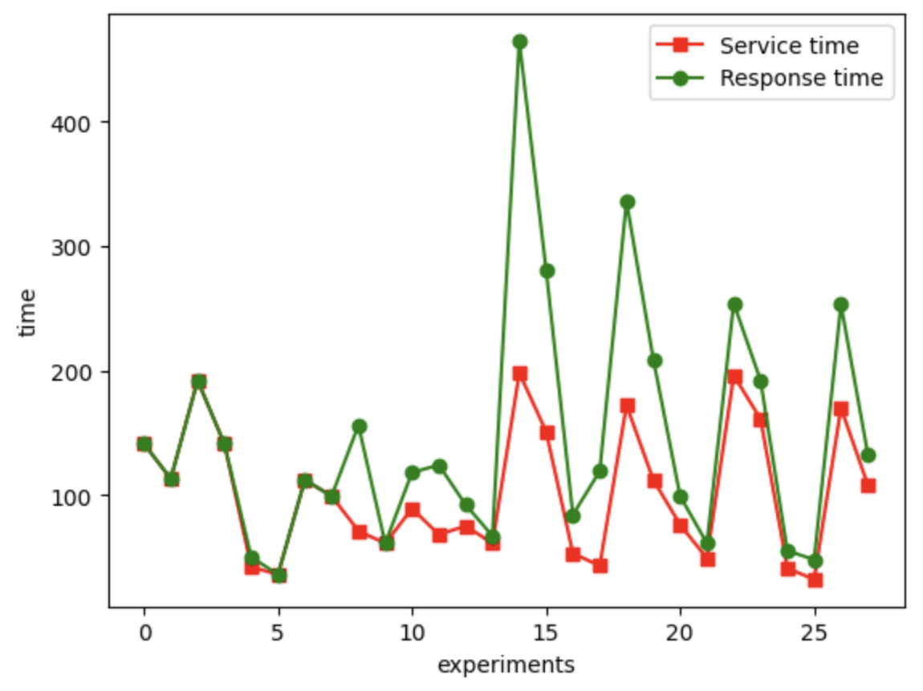
Validation
Exponential trend

Slide 16
Optimization Strategy
Notes:
Jackson

Slide 17
Two-Phase Learning
As shown by our models, increasing batch size makes a significant difference in performance
Based on our research, it is possible to take advantage of this without losing significant accuracy by splitting training into two parts:
Phase 1: Small batch sizes are used to complete the most critical parts of training
Phase 2: Larger batch sizes are used to speed up epochs during the long tail of the training process
Notes:
Jackson

Slide 18
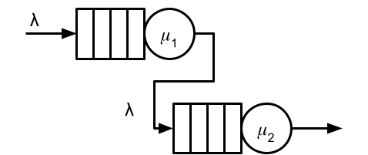
Split System
These two training phases can be split across different systems, which can be allocated the most appropriate hardware
Our experiments tell us that the phase-1 service rate 𝜇₁ would be significantly higher than 𝜇₂ if the two stages were allocated the same hardware
Notes:
Jackson

Slide 19
Questions

